Slide 1
Investigating Feasibility of QUIC on Constrained Devices
Student: Mikhail Dyuldin
Supervisor: Stefan Weber
Date 20/07/2021

Slide 2






Overview
Background
Challenges
Experiments
Results
Evaluation

Slide 3
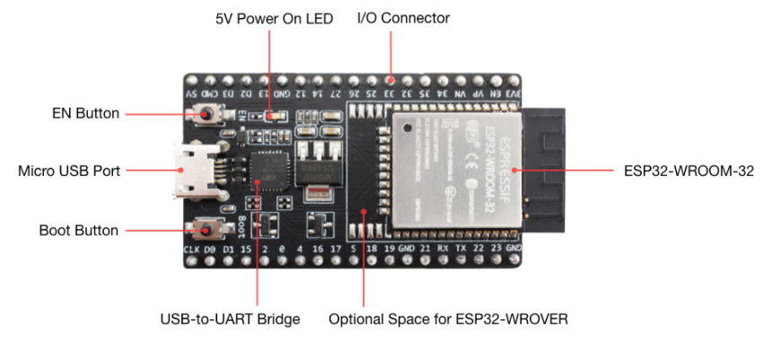
Background
Microcontroller – 2 ESP32 DevKitC’s
2 Cores 80-240MHz Adjustable (160Mhz used)
4MB Flash
8MB PSRAM
Micro USB powered
ESP32-WROVER-E
Comes installed with an ESP32-WROVER-E Module
Allowing communication over Wi-Fi and Bluetooth.
This chip was chosen based on it having this capability.

Slide 4


Background
Frameworks
The ESP32 for this project runs on their native ESP-”IDF”
Many people have heard of Arduino and it is a great framework for beginners but doesn’t allow the fidelity required to fine-tune the tasks running on the MCU.
Benefits: adjusting build type, partition tables for storage, Http client and server behaviour and many more
VS

Slide 5

Background
Protocols
HTTP/0.9
HTTP/1.0
HTTP/1.1
HTTP/2
HTTP/3

Slide 6

Background
Protocols
GET /my-page.html
HTTP/0.9

Slide 7
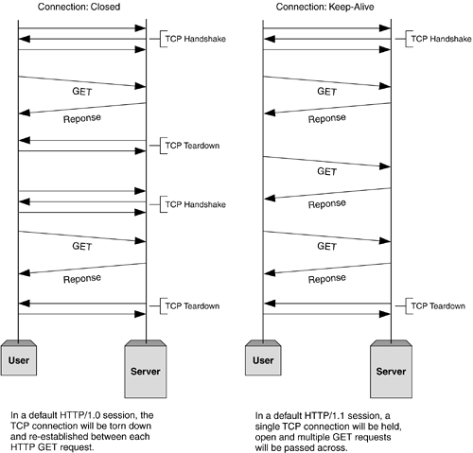
Background
Protocols
Persistent Connections
3-Way Handshakes
Slow start
informit.com

Slide 8
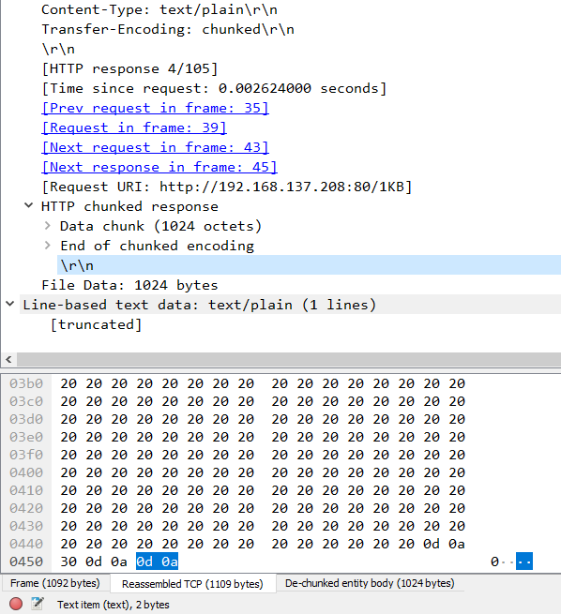
Background
Protocols
Wireshark chunked packet inspection
Data sent out faster with Chunked Transfer-Encoding
No need to buffer data before sending it

Slide 9
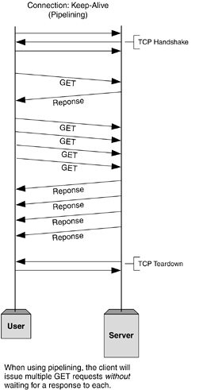

Background
Protocols
Pipelining
Below is an experiment where the ESP
requests files in batches of 55. One does not
Have pipelining and the other does.
(No Pipelining)
(Pipelining)
informit.com

Slide 10
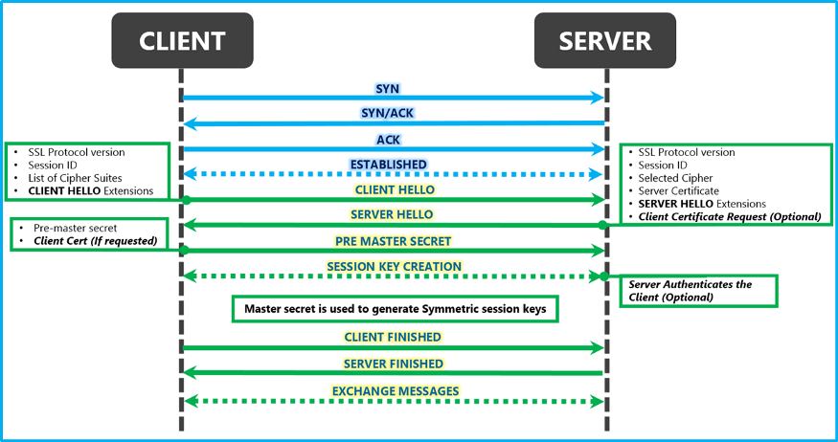
Background
Protocols
SSL Handshake
msdn.microsoft.com

Slide 11
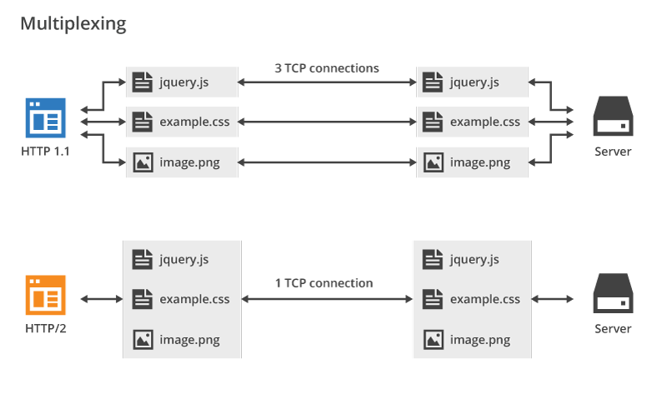
Background
Protocols
HTTP/2
blog.cloudflare.com

Slide 12
Background
Protocols
HTTP/2
Single Connection
Prioritization
Binary
Header Compression
Server Push

Slide 13
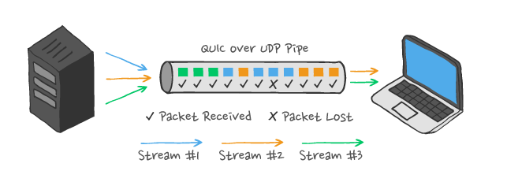
Background
QUIC
Multiplexing with multi-streaming
Single connection
Ably.com

Slide 14
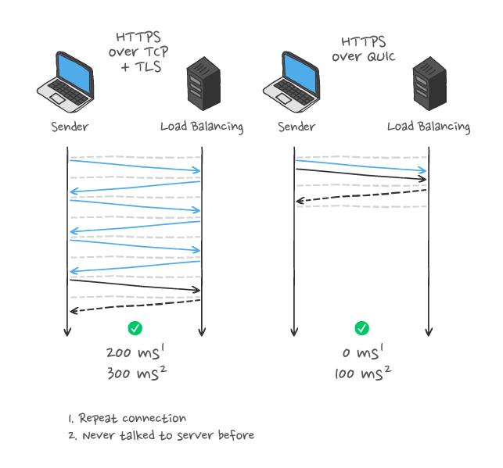
Background
QUIC
Cryptography
Improved Server PUSH
Better Header Compression
Ably.com

Slide 15
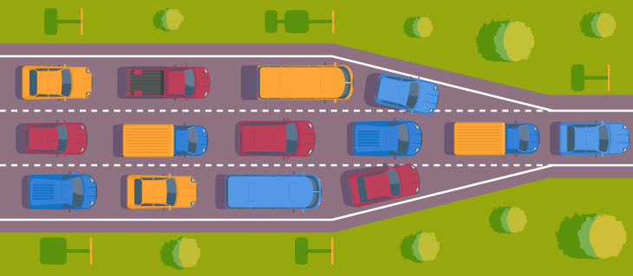
Background
Microcontroller Tie-in
CPU
CPU 160MHz
520KB (total) SRAM
320KB (usable) SRAM
PACKET
PACKET
PACKET
PACKET
PACKET
RAM
Integrify.com

Slide 16
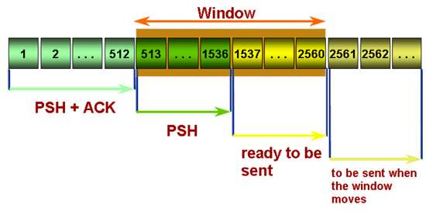
Background
Microcontroller Tie-in
Bytes 1 through 512 have been transmitted (and pushed to the application using the TCP PSH flag) and have been acknowledged by the destination host.
The window is 2,048 bytes long.
Bytes 513 through 1,536 have been transmitted but have not been acknowledged.
Bytes 1,537 through 2,560 can be transmitted immediately.
Once an acknowledgement is received for bytes 513 through 1,536, the window will move 1,024 bytes to the right, and bytes 2,561 through 3,584 may then be sent.
Embedded.com
Text + Image

Slide 17
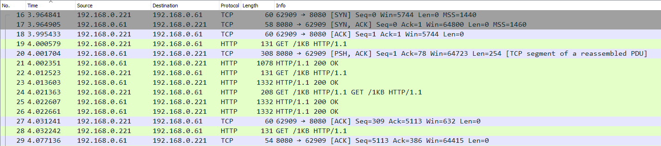
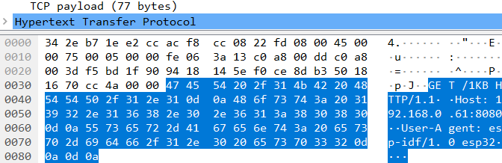
Background
Microcontroller Tie-in
Window: 5744
Window: 64723
Window: 5490
Window: 64646
Window: 3188
Window: 64492
Window: 64492
Window: 632

Slide 18
Challenges
QUIC Implementation by Lars Eggert: Quant
Quant was implemented over Real Time Operating System (RIOT OS) on an ESP32 by Lars.
RIOT-OS based on boards with no Wi-Fi, needed raspberry pi intermediary connect via Bluetooth to MCU and forward over Wi-Fi to server
Quant had picotls and picoquic dependencies which would take a large amount of time to port

Slide 19
Experiments
Clients
Servers
HTTP_request
HTTPS_request
HTTPS_mbedtls
UDP_client
HTTP_file_server
HTTPS_server
UDP_server

Slide 20
Experiments
Clients
Servers
HTTP_request
HTTPS_mbedtls
UDP_client
HTTP_file_server
HTTPS_file_server
UDP_server

Slide 21
Experiments
Clients
Servers
HTTP_request
HTTPS_mbedtls
UDP_client
CURL
Netcat
HTTP_file_server
HTTPS_file_server
UDP_server
Nginx
Netcat

Slide 22
Experiments
Clients
Severs

Slide 23
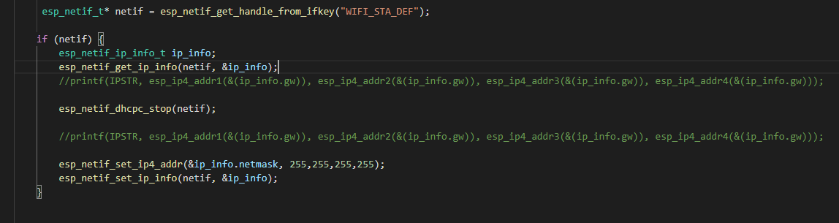
Experiments
IPv4 = 255.255.255.0 => IPv4 = 255.255.255.255

Slide 24
Experiments
Experiments to test :
Http1.0 & Http1.1
TLS
Every combination of connections with constrained and not constrained devices, total of 8 batch tests
Each batch test is broken down into 3 separate tests where 1KB, 10KB, and 100KB are sent consecutively 55 times
The measurements taken are based around the speed of the connections.
As for the header sizes, UDP had slightly smaller header sizes compared to TCP which meant that their MTU was slightly bigger, increasing throughput.

Slide 25
Results /Evaluation

Slide 26
Results /Evaluation

Slide 27
Results /Evaluation

Slide 28
Results /Evaluation

Slide 29
Results /Evaluation

Slide 30
Results /Evaluation

Slide 31
Results /Evaluation

Slide 32
Conclusion
Great Improvements in Performance for HTTP/2 and HTTP/3
Not completely mitigating the constrained nature of MCU’s
Future Work:
New and improved UDP implementation with PSRAM and higher CPU clock speed

Slide 33
Thank You!
Questions?

